Slide 1
© BCS, The Chartered Institute for IT, is the business name of The British Computer Society (Registered charity no. 292786) 2013

Slide 2
The Branch
BCS Bedford Branch has about 870 members registered, about 400 are based in the Bedford area and another 360 in Hertfordshire, Cambridgeshire and Northamptonshire.
The branch aims to promote at a local level the aims of the BCS and to organise events on subjects of interest to the membership. Almost all our events are free and are open to the public.
Notes:
2 Name Changes + Intro Text

Slide 3
Agenda
Welcome and Introductions
Apologies for absence
Minutes of the previous AGM
Matters arising from the minutes
Chair’s report
Treasurer’s report
Reports from Officers on the Committee
Election of Chair, Treasurer, Officers and committee members
Any other business
Notes:
2 Name Changes + Intro Text

Slide 4
Chair’s report
Technical meetings | 9
Student Chapter meetings | 15
University induction talks | 1
Family Day | 1
School Competition Launch and Prize Presentation | 1

Slide 5
Meetings
12/09/17 | Scratch: programming language for 5 years old and beyond (Inc. Branch AGM)
26/09/17 | The Kata of Change - How to Flow with the Unknown
5/12/17 | Digital Aviation - e-enabled Aircraft and Implications
6/02/18 | "User Friendliness - ‘P’ soup"
22/02/18 | GDPR: Of course you are ready (collaboration with Bedfordshire Police regional cyber trust group)
21/03/18 | High Performance Computing in Cranfield University
18/04/18 | Demystifying data - What truly is big data, IoT, the cloud and being "data driven"?
22/05/18 | Changing Security Behaviours – From Knowing to Doing
26/06/18 | IOT Update including Smart Metering, Smart Cities
12/0718 | BCS Bedford Challenge School Competition Prize Award
22/07/18 | Bletchley Park - The National Museum of Computing - Family Day

Slide 6
Uni of Bedfordshire Students Chapter
26/09/17 | Introduction to the Beds Comp SU Society / BCS Student Chapter
11/10/17 | Welcome to the Beds Computing Society - Introductory Games Night
18/10/17 | TUI job opportunities
25/10/17 | Student Visit to TUI’s Luton HQ
22/11/17 | TUI Hackathon 2.0
22/11/17 | Talk on Making a Career in Software Development
2/12/17 | Penetration Testing 101 Boot Camp
13/12/17 | FAST LANE Programming Workshop
16/12/17 | Pentesting Boot Camp 2.0 (Competition)
8/01/18 | My First Year Since Graduating in IT Security
24/01/17 | Programming Workshop - Learn Rapid Application Development from Scratch with Sparta Global
10/04/18 | IBM Blockchain Workshop
25/05/18 | Robotics Showcase of Year 2 (Computer Science and Robotics) Student Projects

Slide 7
Student Prizes
University of Buckingham | Alastair Cota Best Performing Graduate in Applied Computing
Open University | Joseph Benjamin Cooper Best project for The Computing and IT Project
Cranfield University | Alice Michel Best Performing student in Management and Information Systems
University of Bedfordshire | Justyna Kurczaba Best Performing Year 1 student in Computing

Slide 8
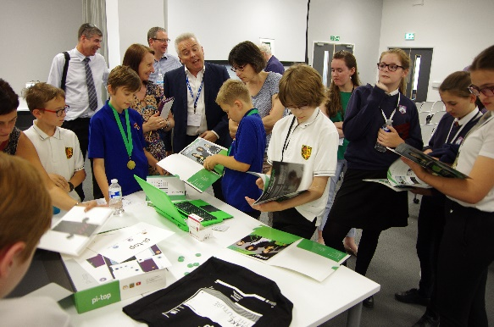
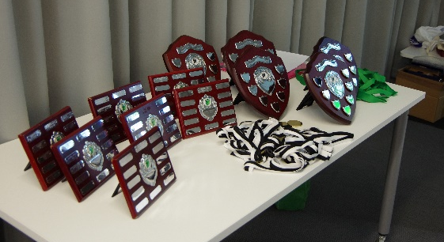
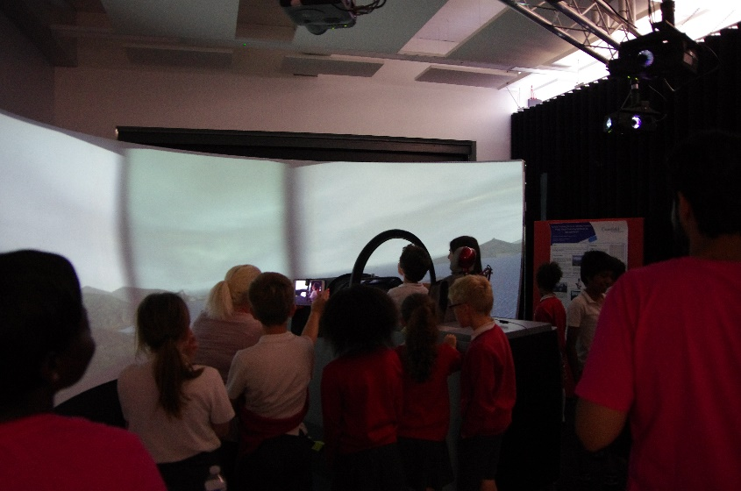
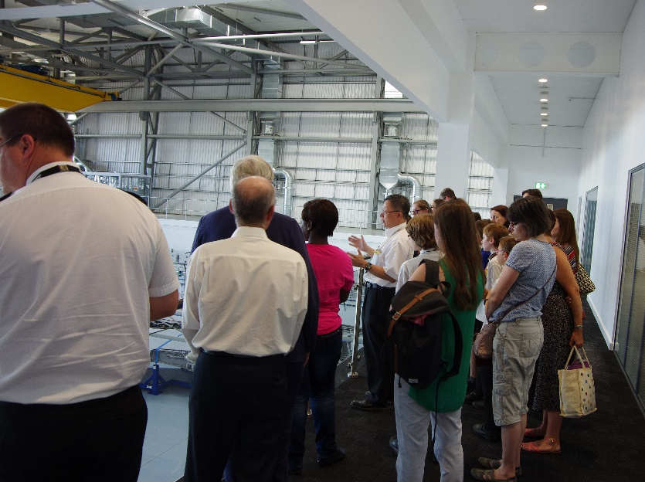
BCS Bedford Challenge Schools Competition

Slide 9
Engagement
Members
LinkedIn
Members Survey
Membership data analysis
Partners
Bedford College
BCS neighbour branches
IET Bedfordshire & Hertfordshire branch
FSB North Bucks
Computing At School
Open University
Cranfield University
University of Buckingham
University of Bedfordshire
Community
Businesses
Business support
Media
Schools

Slide 10
Treasurer’s Report Dr Richard Maddison
Job description
Each March bid for next year (Sept to Aug) budget, get decision in August
Keep a Forecast Outturn spreadsheet
Attend committee meetings, report on financial position, emails
Liaise with BCS HQ
Deal with End-of-year issues, accruals, produce accounts
2017-8
Bid in March 2017 was £4150 Meetings including TNMOC £2200, Student prizes £800, Schools Challenge £1050. £4150
All authorised, so Total available £4150
We needed extra for schools prizes for Yeas 5 & 6, as previous years were for school Years 7, 8 * 9 only - so planned to spend less on meetings
Notes:
Bid is a big job,
Special projects such as our schools challenge competition have to be bid for as separate SFR
Everything needs detailed justification, & which month for each amount
Keep within authorised and in HQ’s good books

Slide 11
Outturn, Accounts
Expenditure (excluding VAT reclaimed) Actual Budget
Meetings, room hire, catering, speakers travel 1107 2250
Family day TNMOC £505; with income £100 405
Student prizes: 3 of 4 university students £150 each plus BCS memberships 600 850
Schools Challenge £784, plus £694 from 2017 1478 1050
Total 3590 4150
Budget 2017-8
Bid £3700 + Schools Supplementary Funding £1050 4150
Underspend 560
Committee didn’t incur/claim any expenses: travel, printing, admin
Rooms & catering arranged for less than budget bid or free to us
Actuals are after claiming VAT back, eg £100 became £83.33
Notes:
TNMOC 20 members at about £20 each, £5 income each
Schools prizes 2016 presented Jan 2017 £888, plus £929 actual for 2017 = £1917

Slide 12
2018-9 Bid
Bid (excluding VAT to be reclaimed)
Meetings, including TNMOC 2400
Student prizes & memberships 850
Schools Challenge Competition as Supplementary Funding Request (SFR) 1300
Total 3700
Bid made on 6 April 2018
Allocated £2750 on 31 August 2018 2750
Schools £1300 was not authorised and Meetings cut. They have cut all catering budgets to make savings..
We spent £3590 in 2017-8, including £694 from 2016-7, giving £2896 as the ‘real’ amount for the 2017-8 year.
Notes:
I thank the committee for arranging the meetings within the budget

Slide 13
Officer’s Report

Slide 14
Election Results
Chairman / Email Co-ordinator
Secretary / Email Co-ordinator
Treasurer
Webmaster
Events Coordinator Education Liaison Officer Membership Secretary
Committee member / Project Management
Committee Member / Social Media
Committee member / Schools Project
Committee member / Shadowing Treasurer
YPG Committee member

Slide 15
A.O.B.

